Slide 1
Chapter 2
Computer Abstractions and Technology
Lesson 6-7: MIPS (cont…)

Slide 2
Character Data
Byte-encoded character sets
ASCII: 128 characters
95 graphic, 33 control
Latin-1: 256 characters
ASCII, +96 more graphic characters
Unicode: 32-bit character set
Used in Java, C++ wide characters, …
Most of the world’s alphabets, plus symbols
UTF-8, UTF-16: variable-length encodings
§2.9 Communicating with People

Slide 3
Byte/Halfword Operations
Could use bitwise operations
MIPS byte/halfword load/store
String processing is a common case
lb rt, offset(rs) lh rt, offset(rs)
Sign extend to 32 bits in rt
lbu rt, offset(rs) lhu rt, offset(rs)
Zero extend to 32 bits in rt
sb rt, offset(rs) sh rt, offset(rs)
Store just rightmost byte/halfword

Slide 4
String Copy Example
C code (naïve):
Null-terminated string
void strcpy (char x[], char y[]) { int i; i = 0; while ((x[i]=y[i])!='\0') i += 1; }
Addresses of x, y in $a0, $a1
i in $s0

Slide 5
String Copy Example
void strcpy (char x[],char y[]) { int i; i = 0; while ((x[i]=y[i])!='\0') i += 1; }
MIPS code:
strcpy: addi $sp, $sp, -4 # adjust stack for 1 item sw $s0, 0($sp) # save $s0 add $s0, $zero, $zero # i = 0 L1: add $t1, $s0, $a1 # addr of y[i] in $t1 lbu $t2, 0($t1) # $t2 = y[i] add $t3, $s0, $a0 # addr of x[i] in $t3 sb $t2, 0($t3) # x[i] = y[i] beq $t2, $zero, L2 # exit loop if y[i] == 0 addi $s0, $s0, 1 # i = i + 1 j L1 # next iteration of loop L2: lw $s0, 0($sp) # restore saved $s0 addi $sp, $sp, 4 # pop 1 item from stack jr $ra # and return

Slide 6
32-bit Constants
Most constants are small
16-bit immediate is sufficient
For the occasional 32-bit constant
lui rt, constant
Copies 16-bit constant to left 16 bits of rt
Clears right 16 bits of rt to 0
§2.10 MIPS Addressing for 32-Bit Immediates and Addresses
lhi $s0, 61
0000 0000 0111 1101 0000 0000 0000 0000
ori $s0, $s0, 2304
0000 0000 0111 1101 0000 1001 0000 0000

Slide 7
Branch Addressing
Branch instructions specify
Opcode, two registers, target address
Most branch targets are near branch
Forward or backward
op
rs
rt
constant or address
6 bits
5 bits
5 bits
16 bits

Slide 8
Branch Addressing
PC-relative addressing
Increment the PC with an offset relative to the address of the following PC instruction (i.e. PC+4) as opposed to the current instruction
PC-relative addresses refer to the number of words to the next instruction instead of the number of bytes.
To Target address = PC + offset × 4
Shift Left the PC by 2 first, then add offset

Slide 9
Jump Addressing
Jump (j and jal) targets could be anywhere in text segment
Encode full address in instruction
op
address
6 bits
26 bits
(Pseudo)Direct jump addressing
Target address = PC_{31…28} : (address × 4)
When jump address is 26 bits of the instruction concatenated with the upper bits of the PC

Slide 10
Target Addressing Example
Loop code from earlier example
Assume Loop at location 80000
Loop: sll $t1, $s3, 2 | 80000 | 0 | 0 | 19 | 9 | 4 | 0
add $t1, $t1, $s6 | 80004 | 0 | 9 | 22 | 9 | 0 | 32
lw $t0, 0($t1) | 80008 | 35 | 9 | 8 | 0
bne $t0, $s5, Exit | 80012 | 5 | 8 | 21 | 2
addi $s3, $s3, 1 | 80016 | 8 | 19 | 19 | 1
j Loop | 80020 | 2 | 20000
Exit: … | 80024

Slide 11
Branching Far Away
If branch target is too far to encode with 16-bit offset, assembler rewrites the code
Example
beq $s0,$s1, L1
↓
bne $s0,$s1, L2 j L1 L2: …

Slide 12
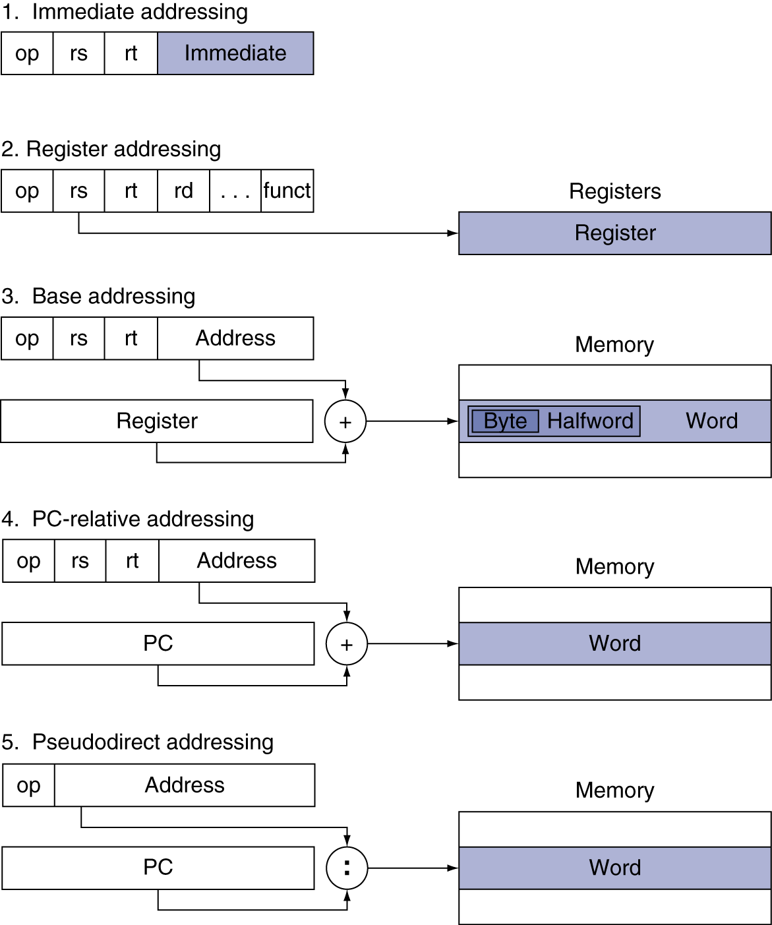
Addressing Mode Summary

Slide 13
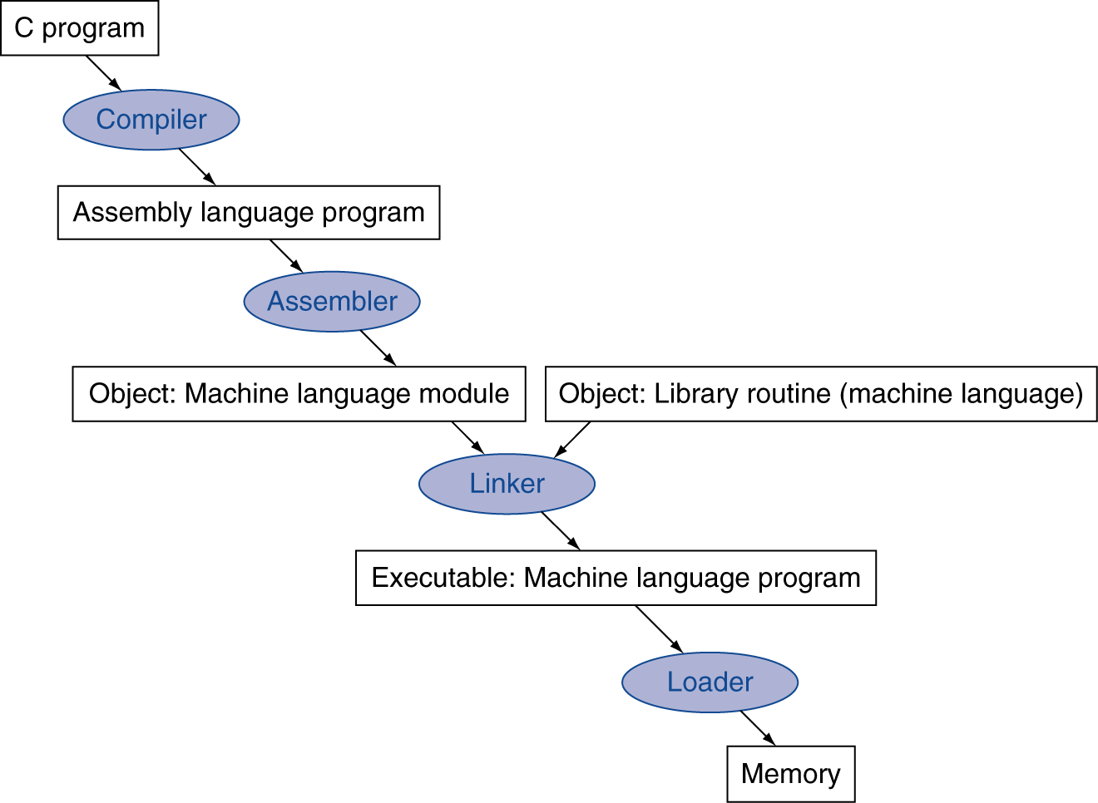
Translation and Startup
Many compilers produce object modules directly
§2.12 Translating and Starting a Program
Static linking

Slide 14
Assembler Pseudoinstructions
Most assembler instructions represent machine instructions one-to-one
Pseudoinstructions: figments of the assembler’s imagination
move $t0, $t1 → add $t0, $zero, $t1
blt $t0, $t1, L → slt $at, $t0, $t1 bne $at, $zero, L
$at (register 1): assembler temporary

Slide 15
Producing an Object Module
Assembler (or compiler) translates program into machine instructions
Provides information for building a complete program from the pieces
Header: described contents of object module
Text segment: translated instructions
Static data segment: data allocated for the life of the program
Relocation info: for contents that depend on absolute location of loaded program
Symbol table: global definitions and external refs
Debug info: for associating with source code

Slide 16
Linking Object Modules
Produces an executable image
1. Merges segments
2. Resolve labels (determine their addresses)
3. Patch location-dependent and external refs
Could leave location dependencies for fixing by a relocating loader
But with virtual memory, no need to do this
Program can be loaded into absolute location in virtual memory space

Slide 17
Loading a Program
Load from image file on disk into memory
1. Read header to determine segment sizes
2. Create virtual address space
3. Copy text and initialized data into memory
Or set page table entries so they can be faulted in
4. Set up arguments on stack
5. Initialize registers (including $sp, $fp, $gp)
6. Jump to startup routine
Copies arguments to $a0, … and calls main
When main returns, do exit syscall

Slide 18
Dynamic Linking
Only link/load library procedure when it is called
Requires procedure code to be relocatable
Avoids image bloat caused by static linking of all (transitively) referenced libraries
Automatically picks up new library versions

Slide 19
C Sort Example (study by yourself-bring questions)
Illustrates use of assembly instructions for a C bubble sort function
Swap procedure (leaf)
void swap(int v[], int k) { int temp; temp = v[k]; v[k] = v[k+1]; v[k+1] = temp; }
v in $a0, k in $a1, temp in $t0
§2.13 A C Sort Example to Put It All Together

Slide 20
The Procedure Swap (study by yourself-bring questions)
swap: sll $t1, $a1, 2 # $t1 = k * 4
add $t1, $a0, $t1 # $t1 = v+(k*4)
# (address of v[k])
lw $t0, 0($t1) # $t0 (temp) = v[k]
lw $t2, 4($t1) # $t2 = v[k+1]
sw $t2, 0($t1) # v[k] = $t2 (v[k+1])
sw $t0, 4($t1) # v[k+1] = $t0 (temp)
jr $ra # return to calling routine

Slide 21
The Sort Procedure in C (study by yourself-bring questions)
Non-leaf (calls swap)
void sort (int v[], int n)
{
int i, j;
for (i = 0; i < n; i += 1) {
for (j = i – 1;
j >= 0 && v[j] > v[j + 1];
j -= 1) {
swap(v,j);
}
}
}
v in $a0, k in $a1, i in $s0, j in $s1

Slide 22
The Procedure Body (study by yourself-bring questions)
move $s2, $a0 # save $a0 into $s2
move $s3, $a1 # save $a1 into $s3
move $s0, $zero # i = 0
for1tst: slt $t0, $s0, $s3 # $t0 = 0 if $s0 ≥ $s3 (i ≥ n)
beq $t0, $zero, exit1 # go to exit1 if $s0 ≥ $s3 (i ≥ n)
addi $s1, $s0, –1 # j = i – 1
for2tst: slti $t0, $s1, 0 # $t0 = 1 if $s1 < 0 (j < 0)
bne $t0, $zero, exit2 # go to exit2 if $s1 < 0 (j < 0)
sll $t1, $s1, 2 # $t1 = j * 4
add $t2, $s2, $t1 # $t2 = v + (j * 4)
lw $t3, 0($t2) # $t3 = v[j]
lw $t4, 4($t2) # $t4 = v[j + 1]
slt $t0, $t4, $t3 # $t0 = 0 if $t4 ≥ $t3
beq $t0, $zero, exit2 # go to exit2 if $t4 ≥ $t3
move $a0, $s2 # 1st param of swap is v (old $a0)
move $a1, $s1 # 2nd param of swap is j
jal swap # call swap procedure
addi $s1, $s1, –1 # j –= 1
j for2tst # jump to test of inner loop
exit2: addi $s0, $s0, 1 # i += 1
j for1tst # jump to test of outer loop
Move params
Outer loop
Inner loop
Pass params & call
Inner loop
Outer loop

Slide 23
The Full Procedure (study by yourself-bring questions)
sort: addi $sp,$sp, –20 # make room on stack for 5 registers
sw $ra, 16($sp) # save $ra on stack
sw $s3,12($sp) # save $s3 on stack
sw $s2, 8($sp) # save $s2 on stack
sw $s1, 4($sp) # save $s1 on stack
sw $s0, 0($sp) # save $s0 on stack
… # procedure body
…
exit1: lw $s0, 0($sp) # restore $s0 from stack
lw $s1, 4($sp) # restore $s1 from stack
lw $s2, 8($sp) # restore $s2 from stack
lw $s3,12($sp) # restore $s3 from stack
lw $ra,16($sp) # restore $ra from stack
addi $sp,$sp, 20 # restore stack pointer
jr $ra # return to calling routine

Slide 24
Arrays vs. Pointers (study by yourself-bring questions)
Array indexing involves
Multiplying index by element size
Adding to array base address
Pointers correspond directly to memory addresses
Can avoid indexing complexity
§2.14 Arrays versus Pointers

Slide 25
Example: Clearing an Array (study by yourself-bring questions)
clear1(int array[], int size) { int i; for (i = 0; i < size; i += 1) array[i] = 0; } | clear2(int *array, int size) { int *p; for (p = &array[0]; p < &array[size]; p = p + 1) *p = 0; }
move $t0,$zero # i = 0 loop1: sll $t1,$t0,2 # $t1 = i * 4 add $t2,$a0,$t1 # $t2 = # &array[i] sw $zero, 0($t2) # array[i] = 0 addi $t0,$t0,1 # i = i + 1 slt $t3,$t0,$a1 # $t3 = # (i < size) bne $t3,$zero,loop1 # if (…) # goto loop1 | move $t0,$a0 # p = & array[0] sll $t1,$a1,2 # $t1 = size * 4 add $t2,$a0,$t1 # $t2 = # &array[size] loop2: sw $zero,0($t0) # Memory[p] = 0 addi $t0,$t0,4 # p = p + 4 slt $t3,$t0,$t2 # $t3 = #(p<&array[size]) bne $t3,$zero,loop2 # if (…) # goto loop2

Slide 26
In Conclusion - Fallacies
Powerful instruction ⇒ higher performance
Fewer instructions required
But complex instructions are hard to implement
May slow down all instructions, including simple ones
Compilers are good at making fast code from simple instructions
Use assembly code for high performance
But modern compilers are better at dealing with modern processors
More lines of code ⇒ more errors and less productivity
§2.18 Fallacies and Pitfalls

Slide 27
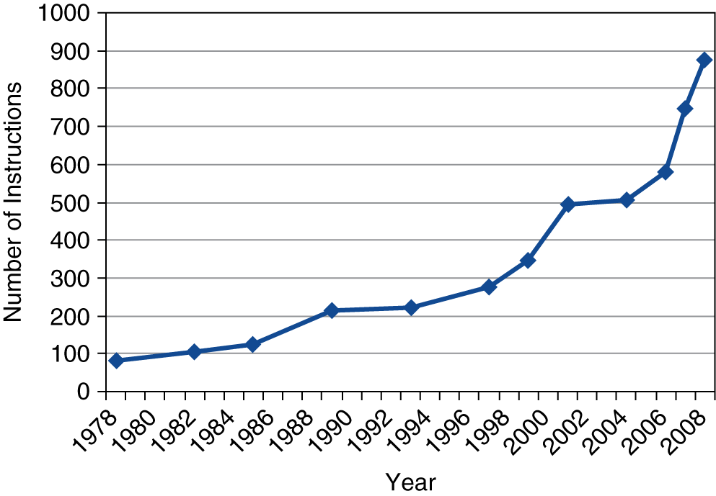
In Conclusion - Pitfalls
Sequential words are not at sequential addresses
Increment by 4, not by 1!
Keeping a pointer to an automatic variable after procedure returns
e.g., passing pointer back via an argument
Pointer becomes invalid when stack popped
Backward compatibility ⇒ instruction set doesn’t change
But they do accrete more instructions
x86 instruction set

Slide 28
In Conclusion - Concluding Remarks
Design principles
1. Simplicity favors regularity
2. Smaller is faster
3. Make the common case fast
4. Good design demands good compromises
Layers of software/hardware
Compiler, assembler, hardware
MIPS: typical of RISC ISAs
Measure MIPS instruction executions
in benchmark programs
§2.19 Concluding Remarks
Instruction class | MIPS examples | SPEC2006 Int | SPEC2006 FP
Arithmetic | add, sub, addi | 16% | 48%
Data transfer | lw, sw, lb, lbu, lh, lhu, sb, lui | 35% | 36%
Logical | and, or, nor, andi, ori, sll, srl | 12% | 4%
Cond. Branch | beq, bne, slt, slti, sltiu | 34% | 8%
Jump | j, jr, jal | 2% | 0%

Slide 29
Next Time
We start Ch 3 – Arithmetic for Computers

